Slide 1
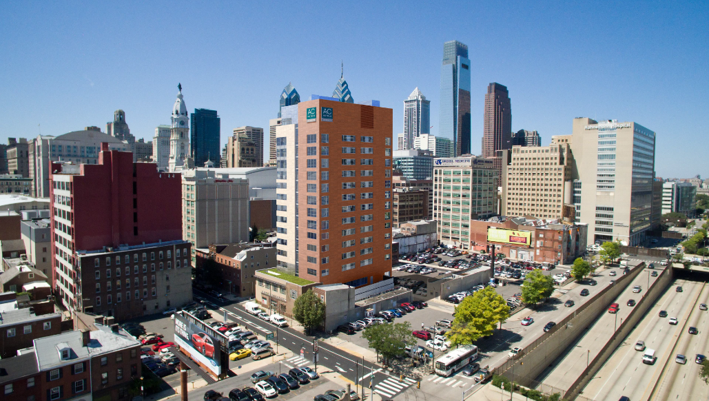
Jesse Bordeau
Final Thesis Presentation
AC Hotel
Philadelphia
By Marriott
230 North 13th Street, Philadelphia Pa
Advisors:
Spring 2016- Dr. Linda Hanagan, PhD, P.E.
Fall 2015- Prof. Heather Sustersic, P.E.
Department of Architectural Engineering
Structural Option
Spring 2016
1

Slide 2
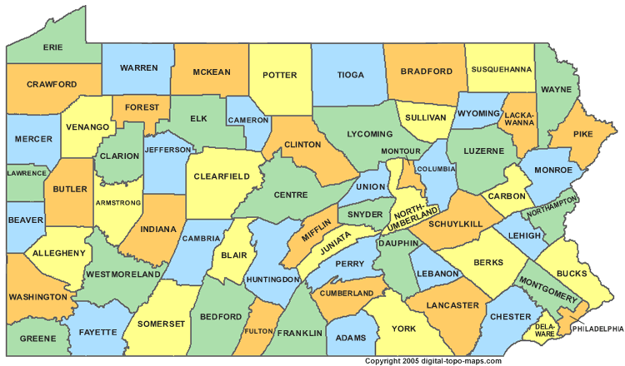

Presentation Overview
Existing Conditions
  Site Location
  Building Information
  Existing Structure
Proposal
Structural Redesign
  Gravity
  Lateral
Breadth Topics
  Construction Management
Conclusion
  Appendix
2
Courtesy of digital-topo-maps.com

Slide 3
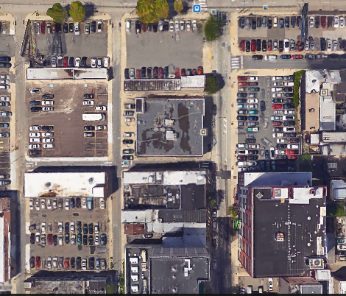
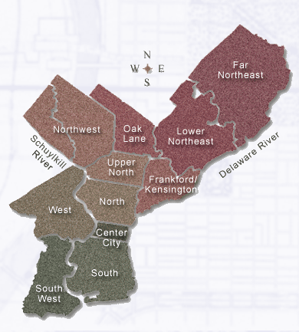
N
Existing Conditions
  Site Location
  Building Information
  Existing Structure
Proposal
Structural Redesign
  Gravity
  Lateral
Breadth Topics
  Construction Management
Conclusion
  Appendix
Building Location
Clarion St.
13th St.
Florist St.
3
Courtesy of digital-topo-maps.com
Courtesy of google maps

Slide 4
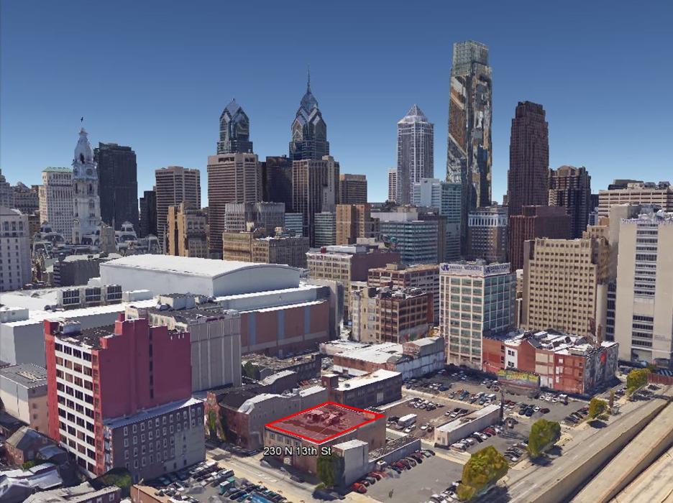
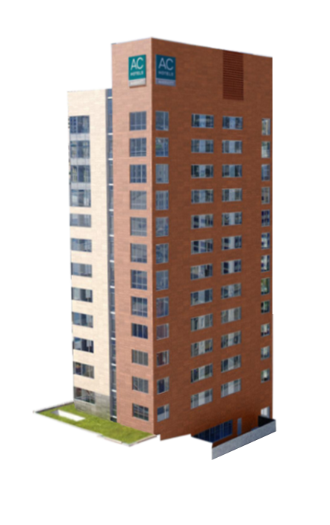
N
Existing Conditions
  Site Location
  Building Information
  Existing Structure
Proposal
Structural Redesign
  Gravity
  Lateral
Breadth Topics
  Construction Management
Conclusion
  Appendix
Building Location
Clarion St.
13th St.
Florist St.
4
Courtesy of Google Earth & HAA for Rendering

Slide 5
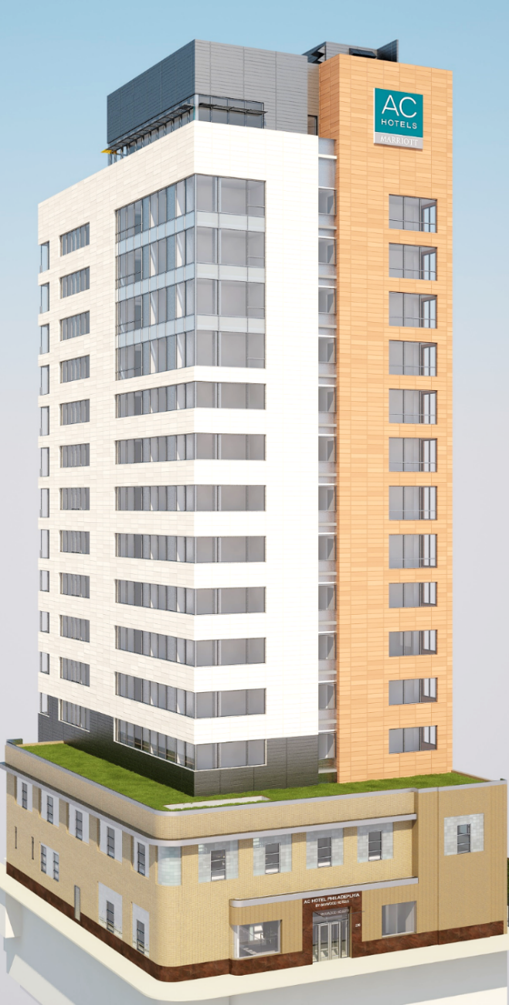
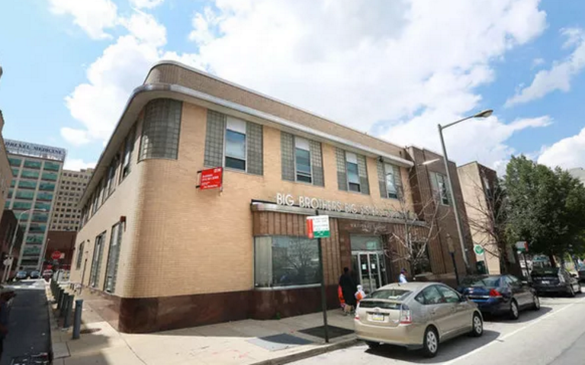
past
Prior uses (Built in 1946)
  NFL Film Studio
  Warner Bros. Distribution Center
  Big Brothers Big Sisters’ Nat’l Headquarters (1984-2014)
present
Residential Transient Hotel (R-1)
  Type 1-B
    Exterior Walls
    Ceiling/Floor Separation 2 HR.
    Structural Frame
    Ceiling/Roof Assembly 1 HR.
192’ Above sidewalk grade
  Garage + 14 levels above grade +
  Penthouse+ Mech. Penthouse
107,680 SF
Proposed Construction:
Fall 15’- Summer 17’
Features:
  Valet parking via car lift
  150 guest room units
  Restaurant, Fitness Center & Indoor Pool
  Multiple Green Roofs (intensive & Extensive)
Existing Conditions
  Site Location
  Building Information
  Existing Structure
Proposal
Structural Redesign
  Gravity
  Lateral
Breadth Topics
  Construction Management
Conclusion
  Appendix
}
5
Courtesy of philly.curbed.com
Courtesy of HAA

Slide 6
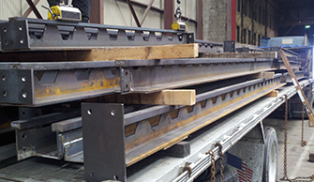
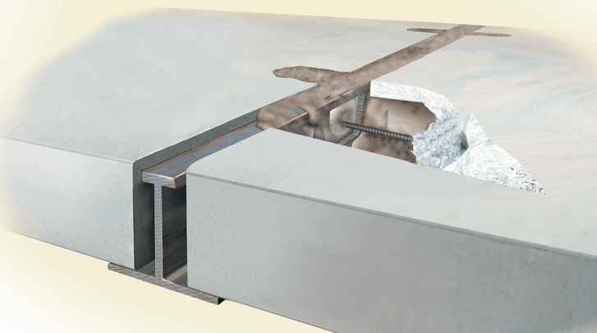
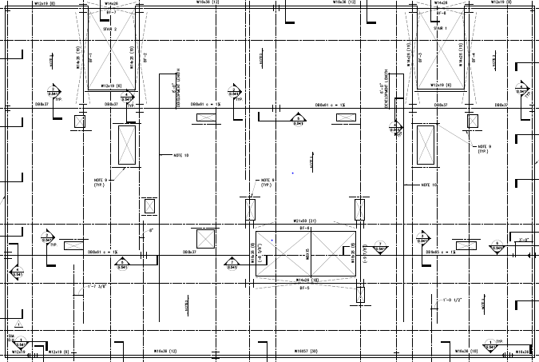
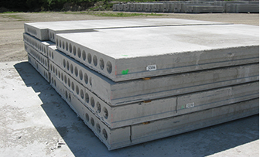
Gravity System
Floor System: Girder-Slab
  D-Beam
  8” Hollow-Core Plank (4’0” typ)
Columns: Wide Flange Members (W14 typ.)
Typical Bay: 17.5’ x 24’
Existing Conditions
  Site Location
  Building Information
  Existing Structure
Proposal
Structural Redesign
  Gravity
  Lateral
Breadth Topics
  Construction Management
Conclusion
  Appendix
91’
60’
6
Courtesy of girder-slab.com & Google Images
Typ. Floor Plan

Slide 7
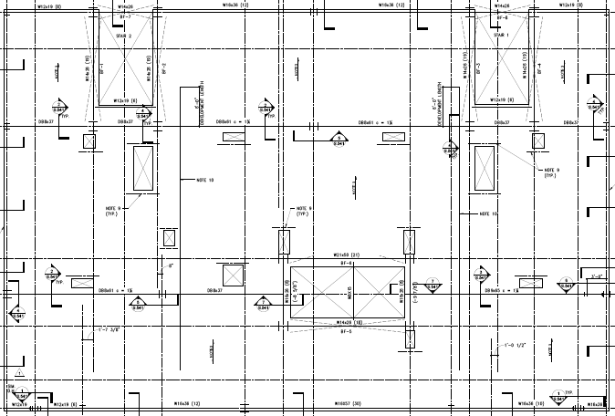
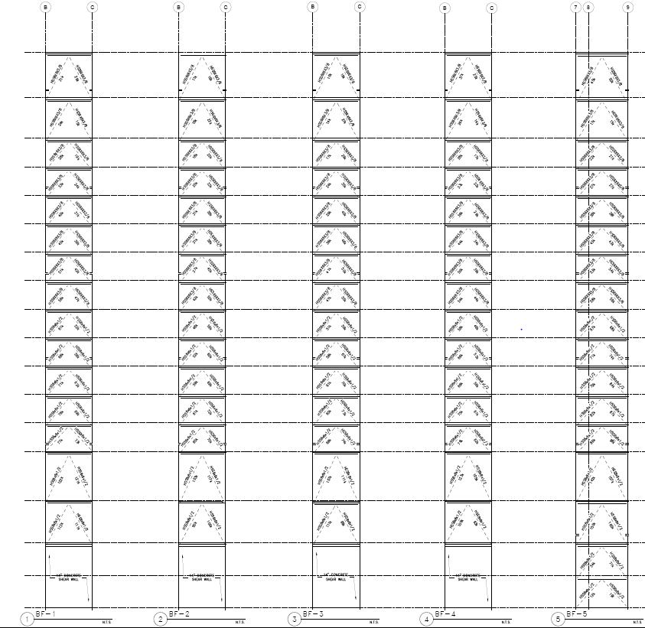
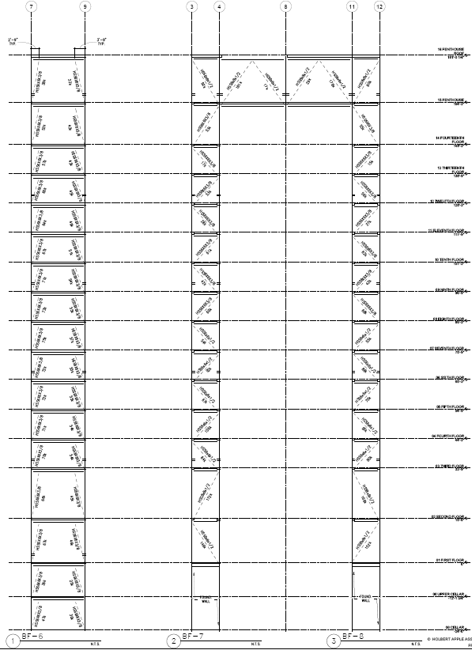
Lateral System
BF-7
BF-8
BF-1
BF-2
BF-3
BF-4
Existing Conditions
  Site Location
  Building Information
  Existing Structure
Proposal
Structural Redesign
  Gravity
  Lateral
Breadth Topics
  Construction Management
Conclusion
  Appendix
BF-6
BF-5
Braced Frames (BF)
  Eight frames, four each direction
  (7) concentric, (1) eccentric
    Floor 8-Roof: HSS6x6x3/8
    Floor 3-7: HSS6x6x1/2
    Floor 1&2: HSS8x8x1/2
7

Slide 8
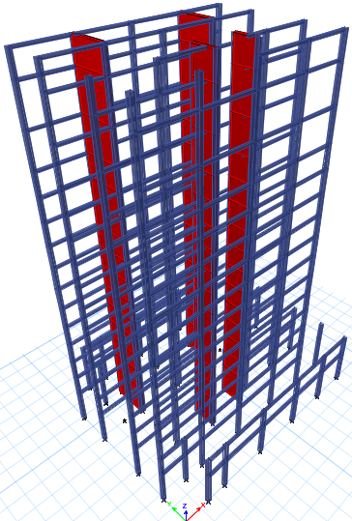
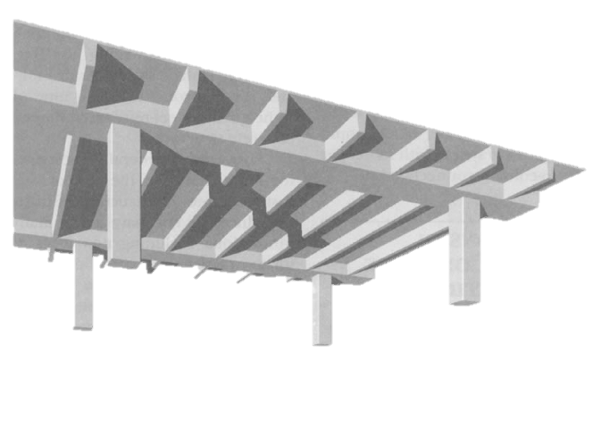
The Modified Structure
Systems
Steel Concrete
Girder-Slab One-way slab w/ beams
Concentric braced frames Concrete Shear Walls & Moment Frames
Existing Conditions
  Site Location
  Building Information
  Existing Structure
Proposal
Structural Redesign
  Gravity
  Lateral
Breadth Topics
  Construction Management
Conclusion
  Appendix
8
Courtesy of studyblue.com

Slide 9
Redesign
Goals
Existing Conditions
  Site Location
  Building Information
  Existing Structure
Proposal
Structural Redesign
  Gravity
  Lateral
Breadth Topics
  Construction Management
Conclusion
  Appendix
Simplify column layout
Maintain floor-to-ceiling height (AC Marriott standard 9’0”)
Provide cost-efficient system
9

Slide 10
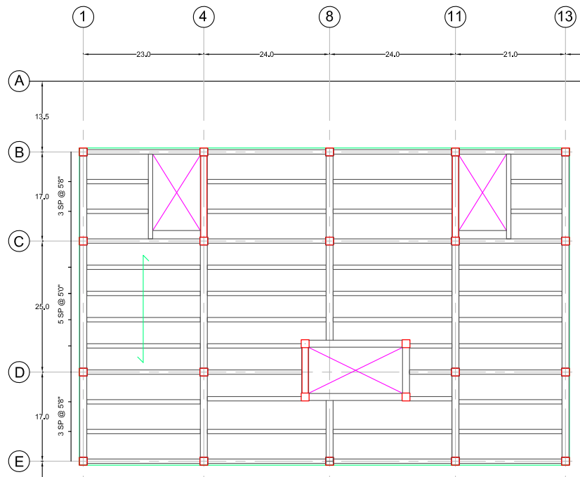
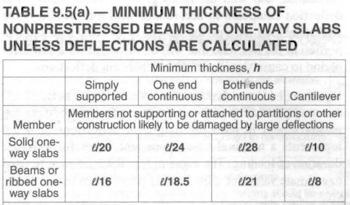
Gravity System – One-way slab w/ beams
24’
Existing Conditions
  Site Location
  Building Information
  Existing Structure
Proposal
Structural Redesign
  Gravity
  Lateral
Breadth Topics
  Construction Management
Conclusion
  Appendix
17’
Slab Design
  Minimum Slab Thickness – ACI 318-11 Table 9.5(a)
    11” min due to 24’ span
    #4 @ 12” O.C.
Interior Beams (4.5’ to 5.66’ O.C.)
  Reduces thickness to 2.4”
    Typ. Floor – 5”
    Lower Floors – 6”
60’
59’
}
Allows for adequate reinforcement space & placement
91’
92’
10
Courtesy of ACI 318-11

Slide 11
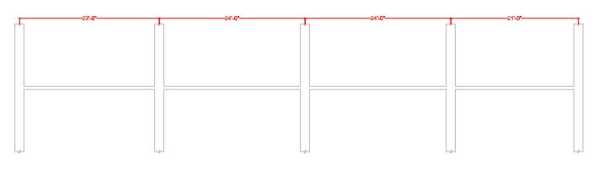
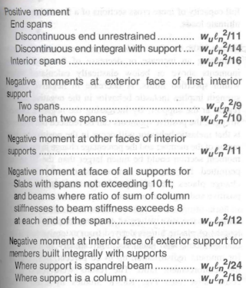
Gravity System – One-way slab w/ beams
Existing Conditions
  Site Location
  Building Information
  Existing Structure
Proposal
Structural Redesign
  Gravity
  Lateral
Breadth Topics
  Construction Management
Conclusion
  Appendix
1
4
8
11
13
Beam Design
  Minimum Thickness – ACI 318-11 Table 9.5(a)
  Moment Approximations – ACI 318-11 Section 8.3.3
5
3
4
4
4
4
3
5
1
2
2
1
1
2
3
4
5
12
Courtesy of ACI 318-11

Slide 12
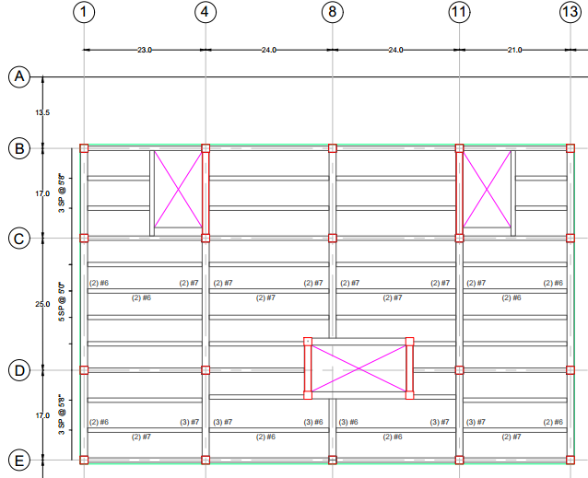
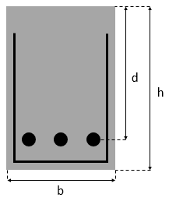
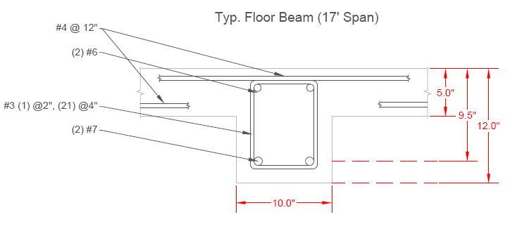








Gravity System – One-way slab w/ beams
Existing Conditions
  Site Location
  Building Information
  Existing Structure
Proposal
Structural Redesign
  Gravity
  Lateral
Breadth Topics
  Construction Management
Conclusion
  Appendix
Beam Design cont.
  Beam dimensions
    Beam
    girder
$d$<1.5b
d<2b
59’
$${As}_{reqd}=\frac{Mu}{4d}$$
$$20Mu<bd^{2}$$
$${As}_{reqd}=\frac{Mu}{0.9fyjd}$$
$$a=\frac{Asfy}{0.85f′cb}$$
$$c=\frac{a}{β}$$
$$ε_{s}=0.005<ε_{c}(\frac{d−c}{c})$$
$$if ε_{c}>ε_{s}∴φ=0.9$$
92’
13

Slide 13
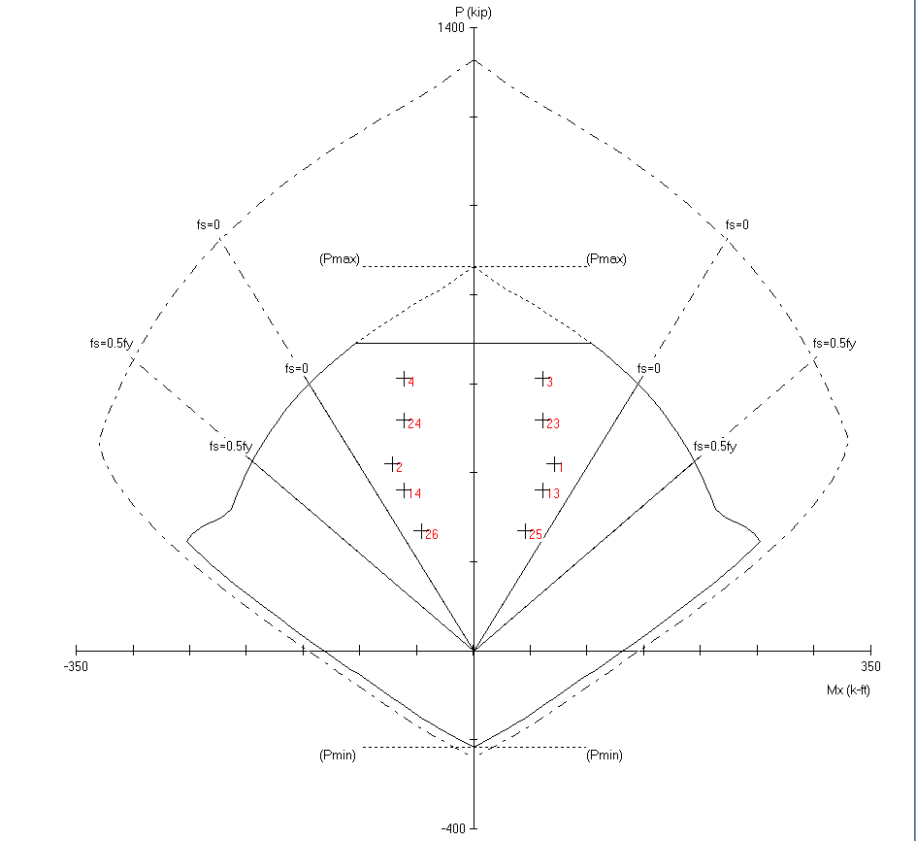
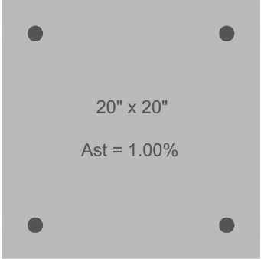
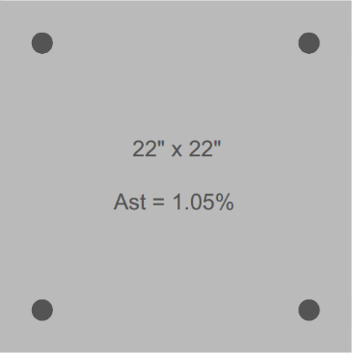
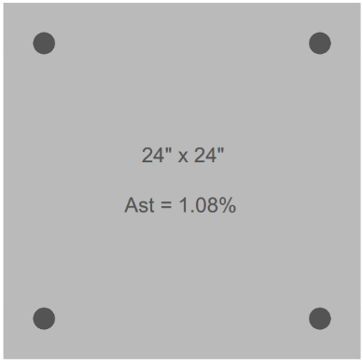
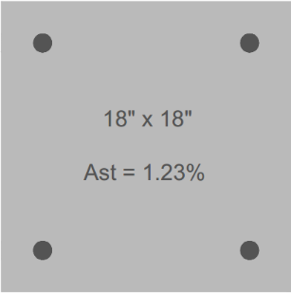
Gravity System – Columns
Existing Conditions
  Site Location
  Building Information
  Existing Structure
Proposal
Structural Redesign
  Gravity
  Lateral
Breadth Topics
  Construction Management
Conclusion
  Appendix
Column Design
  CRSI Manual (Table 3-12)
  Checked for slenderness not slender
Capacity
Load Being Seen
14

Slide 14
Gravity System – Columns
Existing Conditions
  Site Location
  Building Information
  Existing Structure
Proposal
Structural Redesign
  Gravity
  Lateral
Breadth Topics
  Construction Management
Conclusion
  Appendix
Column Design
  CRSI Manual (Table 3-12)
  Checked for slenderness not slender
15

Slide 15
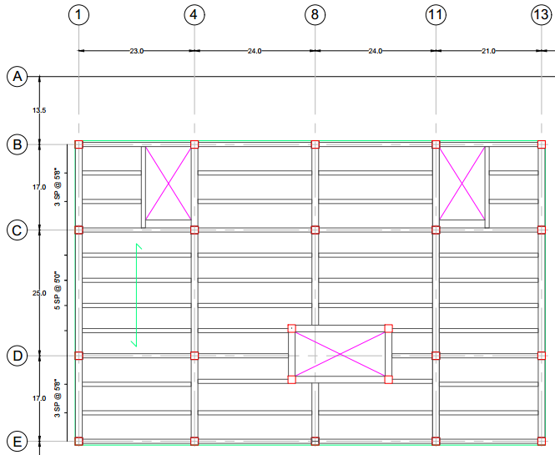
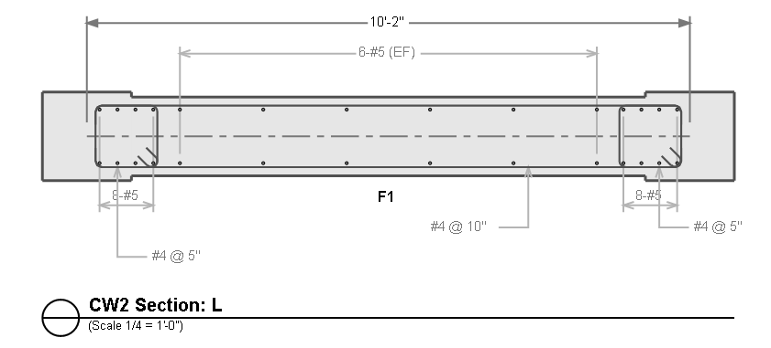
Lateral System
Existing Conditions
  Site Location
  Building Information
  Existing Structure
Proposal
Structural Redesign
  Gravity
  Lateral
Breadth Topics
  Construction Management
Conclusion
  Appendix
Wind controlled
Lateral Force Resisting Elements (LFRE) – Full Building Height
  14” Shear Walls (N-S)
    (2) 17’ long
    (2) 10’ long
  Concrete Moment Frames (E-W)
    (4) 59’ Long
16

Slide 16
Lateral System
Existing Conditions
  Site Location
  Building Information
  Existing Structure
Proposal
Structural Redesign
  Gravity
  Lateral
Breadth Topics
  Construction Management
Conclusion
  Appendix
Wind controlled
Lateral Force Resisting Elements (LFRE) – Full Building Height
  14” Shear Walls (N-S)
    (2) 17’ long
    (2) 10’ long
  Concrete Moment Frames (E-W)
    (4) 59’ Long
17

Slide 17
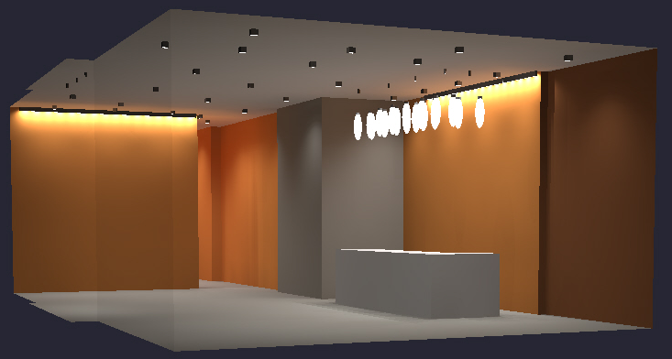
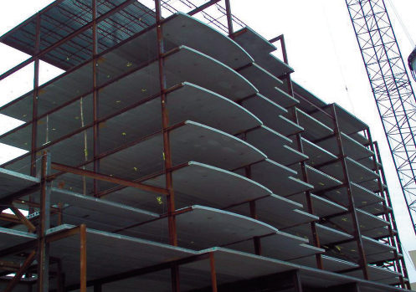
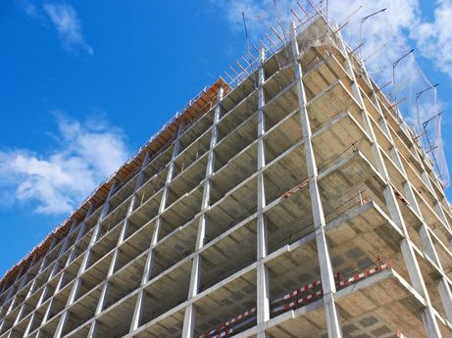
Construction Management
Lighting Redesign
  LED Fluorescent & Compact Fluorescent (CFL)
  Feasibility 20 - year cost comparison
Existing Conditions
  Site Location
  Building Information
  Existing Structure
Proposal
Structural Redesign
  Gravity
  Lateral
Breadth Topics
  Construction Management
Conclusion
  Appendix
  Detailed cost estimate/comparison
  General schedule impacts
VS
Courtesy of www.girder-slab.com
Courtesy of www.groupemagma.ca
18

Slide 18
Detailed Cost Estimate
Structure only
By category
RS Means (Facilities Construction Cost Data - 2014 Edition)
Existing Conditions
  Site Location
  Building Information
  Existing Structure
Proposal
Structural Redesign
  Gravity
  Lateral
Breadth Topics
  Construction Management
Conclusion
  Appendix
19

Slide 19
Estimates
Existing Conditions
  Site Location
  Building Information
  Existing Structure
Proposal
Structural Redesign
  Gravity
  Lateral
Breadth Topics
  Construction Management
Conclusion
  Appendix
20

Slide 20
Estimates
Existing Conditions
  Site Location
  Building Information
  Existing Structure
Proposal
Structural Redesign
  Gravity
  Lateral
Breadth Topics
  Construction Management
Conclusion
  Appendix
21

Slide 21
Estimates
Existing Conditions
  Site Location
  Building Information
  Existing Structure
Proposal
Structural Redesign
  Gravity
  Lateral
Breadth Topics
  Construction Management
Conclusion
  Appendix
22

Slide 22
Estimates
Existing Conditions
  Site Location
  Building Information
  Existing Structure
Proposal
Structural Redesign
  Gravity
  Lateral
Breadth Topics
  Construction Management
Conclusion
  Appendix
23

Slide 23
Estimates
Schedule Impacts
Steel Concrete
Existing Conditions
  Site Location
  Building Information
  Existing Structure
Proposal
Structural Redesign
  Gravity
  Lateral
Breadth Topics
  Construction Management
Conclusion
  Appendix
Stimulants
  Girder-Slab
  More Slim
  Material Consistency
Setbacks
  Erecting steel pieces
  Welding
Stimulants
  Simplified Load Path
  Fire-proofing
  Thermal Properties
Setbacks
  Locating a Contractor
  Formwork/Curing time
24

Slide 24
Goal Review
Existing Conditions
  Site Location
  Building Information
  Existing Structure
Proposal
Structural Redesign
  Gravity
  Lateral
Breadth Topics
  Construction Management
Conclusion
  Appendix
Simplify column layout
Maintain floor-to-ceiling height (AC Marriott standard 9’0”)
Provide cost-efficient system
25

Slide 25
Goal Review
Existing Conditions
  Site Location
  Building Information
  Existing Structure
Proposal
Structural Redesign
  Gravity
  Lateral
Breadth Topics
  Construction Management
Conclusion
  Appendix
Simplify column layout
Maintain floor-to-ceiling height (AC Marriott standard 9’0”)
Provide cost-efficient system
26

Slide 26
Goal Review
Existing Conditions
  Site Location
  Building Information
  Existing Structure
Proposal
Structural Redesign
  Gravity
  Lateral
Breadth Topics
  Construction Management
Conclusion
  Appendix
Simplify column layout
Maintain floor-to-ceiling height (AC Marriott standard 9’0”)
Provide cost-efficient system
27

Slide 27
Goal Review
Existing Conditions
  Site Location
  Building Information
  Existing Structure
Proposal
Structural Redesign
  Gravity
  Lateral
Breadth Topics
  Construction Management
Conclusion
  Appendix
Simplify column layout
Maintain floor-to-ceiling height (AC Marriott standard 9’0”)
Provide cost-efficient system
28

Slide 28
Acknowledgements
Holbert Apple Associates
  David Smith
  Scott Molongoski
AE Faculty
  Dr. Hanagan, PhD, P.E.
  Prof. Sustersic, P.E.
Friends, Classmates & Colleagues
Parents
Existing Conditions
  Site Location
  Building Information
  Existing Structure
Proposal
Structural Redesign
  Gravity
  Lateral
Breadth Topics
  Construction Management
Conclusion
  Appendix
29

Slide 29
Questions/Comments?
Existing Conditions
  Site Location
  Building Information
  Existing Structure
Proposal
Structural Redesign
  Gravity
  Lateral
Breadth Topics
  Construction Management
Conclusion
  Appendix
30

Slide 30
APPENDIX
Existing Conditions
  Site Location
  Building Information
  Existing Structure
Proposal
Structural Redesign
  Gravity
  Lateral
Breadth Topics
  Construction Management
Conclusion
  Appendix

Slide 31
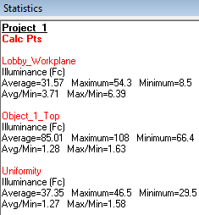
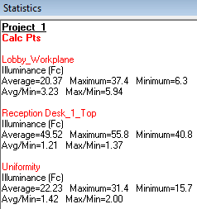
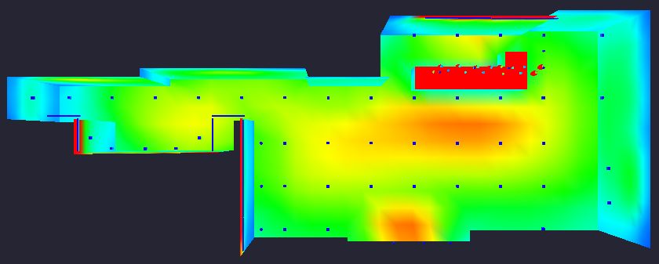

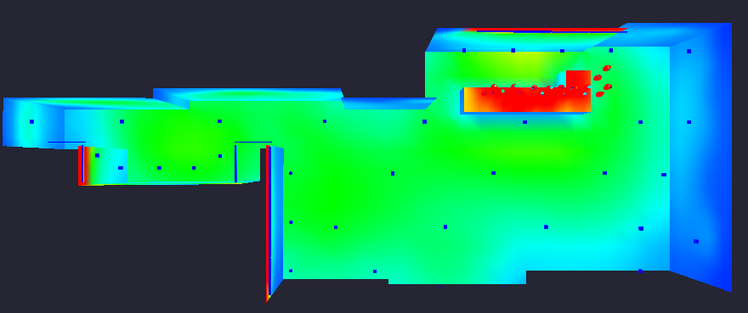
Lighting Redesign
Existing Conditions
  Site Location
  Building Information
  Existing Structure
Proposal
Structural Redesign
  Gravity
  Lateral
Breadth Topics
  Construction Management
Conclusion
  Appendix

Slide 32
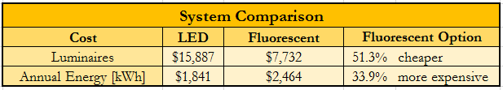
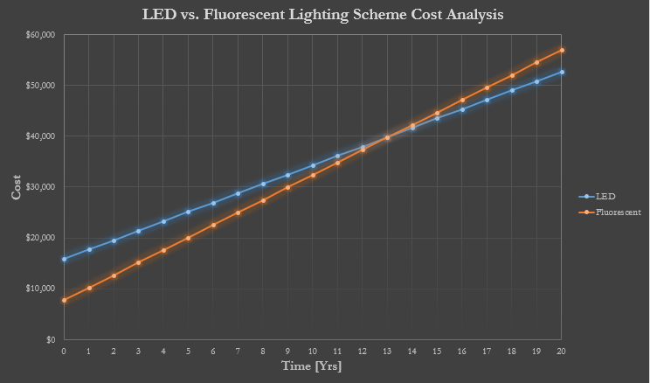
Lighting Redesign
Existing Conditions
  Site Location
  Building Information
  Existing Structure
Proposal
Structural Redesign
  Gravity
  Lateral
Breadth Topics
  Construction Management
Conclusion
  Appendix
B.E.P.

Slide 33
Presentation Overview
Existing Conditions
  Site Location
  Building Information
  Existing Structure
Proposal
Structural Redesign
  Gravity
  Lateral
Breadth Topics
  Construction Management
Conclusion
  Appendix

